Slide 1
Principal Component Analysis
Factor Analysis
Module 3 – Advance Statistics

Slide 2
Objectives
Introduction
Principal Component Analysis
  Procedure
  Coefficients
  Preparing the data
  Should we reduce ?
  Components
  Variance explained
  Eigen values and eigen vectors
  Which components to select ?
  Communality
  Rotation
  Final scores
Exploratory Factor Analysis
  Introduction
  Using Principal Component method
  Using Principal Axis Factoring
  KMO Test

Slide 3
Objectives
Cholestrol ~ Height+Weight
Cholestrol~0.3(H)+0.7(W)
BMI
Multi-collinearity
Many response variable
Many independent varioables that highly corelated

Slide 4
Objectives
Understanding of the data:
Unstructured, multi-collinearity
Eigen Values (Factors)

Slide 5
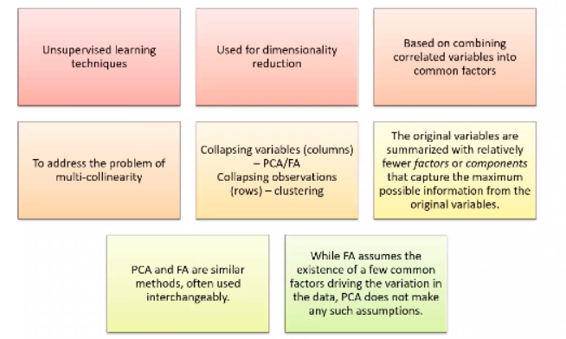
Objectives- PCA and FA Primer

Slide 6
Introduction
Principal Component Analysis (PCA) and Factor Analysis (FA) are data reduction methods.
They are used to re-express multivariate data with fewer dimensions.
The original variables are summarized with relatively fewer factors or components that capture the maximum possible information from the original variables.
PCA and FA are similar methods, often used interchangeably.
While FA assumes the existence of a few common factors driving the variation in the data, PCA does not make any such assumptions.
Factor Analysis
Factors drive the observed variables
Principal Component Analysis
Observed variables are reduced into components
Variable 1
Variable 1
Factor
Component
Variable 2
Variable 2
Variable n
Variable n

Slide 7

Principal Component Analysis
Example:
You are thinking of buying a house and you come with the following points, you should base your criteria upon:
Housing: number of houses / sq km.
Climate
Health Care facilities
Crime Rate
Transportation
Education
Arts and Recreation
For housing and crime rate, the lower the score, the better it is. For all others, higher the score, the better it is.
Objective:
With a large number of variables, the data would be too large to study and interpret properly.
It is sometimes good to reduce the variables to a few, yet interpretable linear combinations, each linear combination
corresponding to a principal component.

Slide 8
Principal Component Analysis: Procedure
Consider X to be a vector, such that:
X = (x1, x2, ….., x7) where, x_{i} = input data variables
The variance-covariance matrix would look like:
σ₁² σ₁₂ ….. σ₁₇
σ₂₁ σ₂² ….. σ₂₇
var (X) = |
σ₇₁ σ₇₂ ….. σ₇²
As the number of variables increases, this matrix becomes more difficult to interpret.
Also, we may have correlations between multiple variables and hence, it is better to represent them using one dimension.
Hence, we try to represent these variables by a smaller set of variables, which are a linear combination of the original variables.
C₁ = m₁₁ x₁ + m₁₂ x₂ + ….. + m₁₇ x₇
C₂ = m₂₁ x₁ + m₂₂ x₂ + ….. + m₂₇ x₇
|
C₇ = m₇₁ x₁ + m₇₂ x₂ + ….. + m₇₇ x₇

Slide 9
Principal Component Analysis: Procedure
First Principal Component (PCA₁): C₁ is the first principal component, which is a linear combination of x-variables that accounts
for as much variation in the data as possible.
The coefficients m₁₁ , m₁₂ , ….. , m₁₇ are defined in such a way that the variance is maximized, subject to the constraint that
the sum of squared coefficients is equal to one i.e.
maximize: var (C₁)
∑ m_{1k}² = m₁₁² + m₁₂² + ….. + m₁₇² = 1
Second Principal Component (PCA₂): C₂ is the second principal component, which is a linear combination of x-variables that
accounts for as much as remaining variation in the data as possible, with the constraint that the correlation between PCA₁ and
PCA₂ is zero. Also, the sum of squared coefficients is equal to one.
maximize: var (C₂)
∑ m_{2k}² = m₂₁² + m₂₂² + ….. + m₂₇² = 1
cov (C_{1 ,}C₂ ) = 0
All subsequent components have the same property - they are linear combinations that account for as much of the remaining
variation as possible and they are not correlated with the other principal components

Slide 10
Principal Component Analysis: Coefficients
Let λ₁, λ₂ ….. λ₇ denote the eigen values of the variance-covariance matrix, ordered such that λ₁ is the largest eigen value and λ₇
is the smallest.
Let vectors e₁, e₂ ….. e₇ denote the eigen vectors.
Then, the variance for an i^{th} principal component is denoted by:
var (C_{i}) = var (e_{i1} x₁ + e_{i2} x₂ + ….. + e_{i7} x₇ ) = λ_{i}
Also, the principal components are uncorrelated with each other.
cov (C_{i} , C_{i}) = 0
Hence, the variance-covariance matrix may be written as a function of eigen values and eigen vectors.
Also, any i^{th} principal component explains the following proportion of the total variation:
λ_{i} .
λ₁+ λ₂ +….. + λ_{n}

Slide 11

PCA: Preparing the data
Iris Data Set: Applying PCA to four continuous variables.
Step 1: Check if the data is numerical; if categorical, it needs to be converted to numerical
str(iris)
Step 2: Check for missing values; choose to ignore or impute.
any(is.na.data.frame(iris))
Step 3: Normalize the variables, if not already normal.
The original predictor variables may have different scales, they need to be normalized before extracting the components.
shapiro.test(iris$sepal_len) => p-value = 0.01018
shapiro.test(iris$sepal_wid) => p-value = 0.07518
shapiro.test(iris$petal_len) => p-value = 7.545e-10
shapiro.test(iris$petal_wid) => p-value = 1.865e-08
qq plot or histogram may also be used.

Slide 12
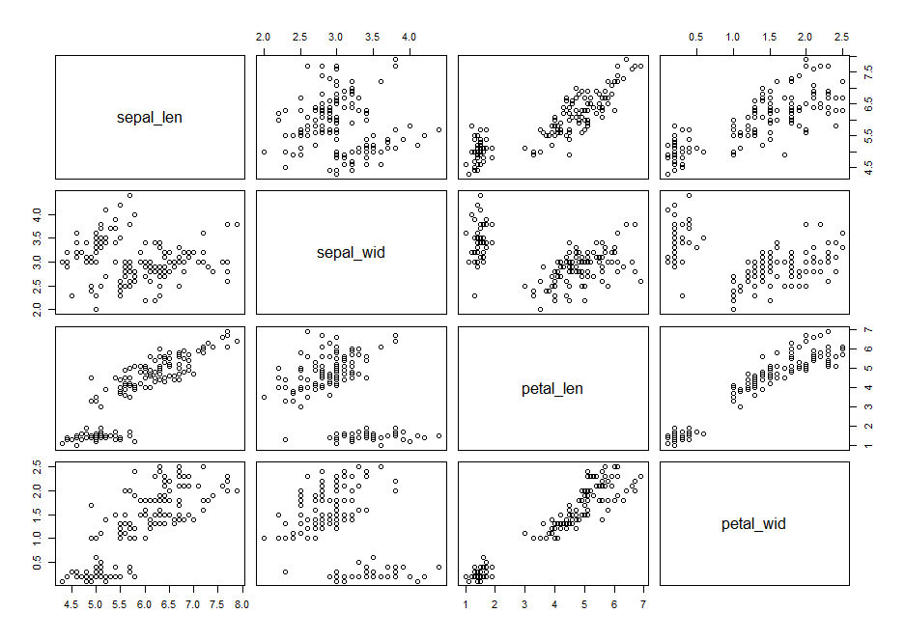

PCA: Should we reduce ?
Step 4: Pair wise Scatterplots
pairs(iris_pca)
sepal_len is highly correlated with
petal_len
sepal_len is also correlated with
petal_wid
sepal_len is not correlated with
sepal_wid
Step 5: Bartlett Sphericity Test
print(cortest.bartlett(cor(iris_pca),
nrow(iris_pca)))
=> Reduction should be done

Slide 13
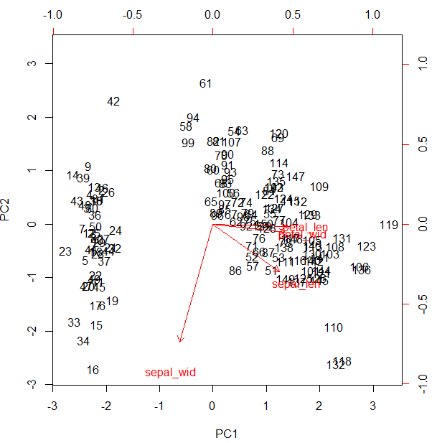
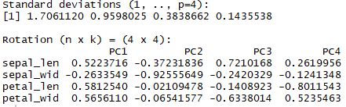
PCA: Components
Step 6: Implement PCA
iris_comp <- prcomp(iris_pca, scale. = T)
Standard Deviation and components:
print(iris_comp)
i.e. PC1 = 0.522 * (sepal_len) – 0.263 * (sepal_wid) + 0.581 * (petal_len) + 0.566 * (petal_wid)
Plotting the resultant principal components.
biplot(iris_comp, scale = 0)

Slide 14

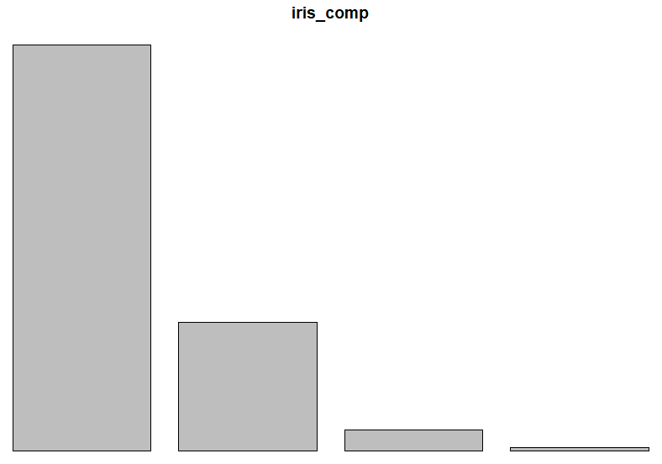
PCA: Variance explained
Step 7: Find the components explaining maximum variance.
summary(iris_comp)
First component (PC1) explains 72.7% of the variance, second component (PC2) explains 23% of the total variance and so on.
Together, PC1 and PC2 explain 95.8% of the total variance.
plot(iris_comp)

Slide 15

PCA: Eigen values and eigen vectors
Step 8:
Eigen value tells the variance explained by a component.
Eigen vector points in the direction where the maximum variance is explained.
cor_iris <- cor(iris_pca)
eigen_iris <- eigen(cor_iris)
eigen_iris$values
eigen_iris$values/sum(eigen_iris$values)
72.7% of the variance is explained by the 1st component, 23% by the second component and so on.
eigen_iris$vectors

Slide 16
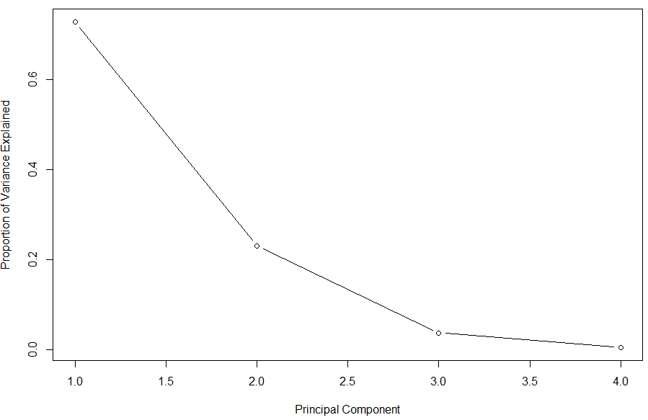
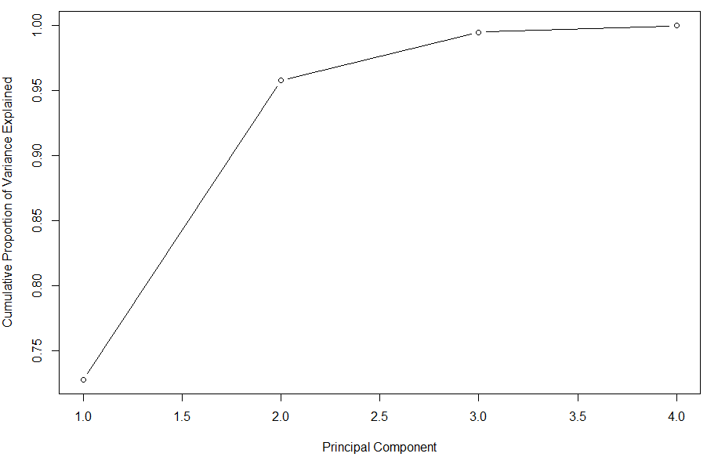
PCA: Which components?
Step 9: How many components to select ?
Scree plot is used to help us choose the number of components we should select, considering the variability of data explained.
plot(iris_prop_varex, xlab = "Principal Component", ylab = "Proportion of Variance Explained", type = "b")
plot(cumsum(iris_prop_varex), xlab = "Principal Component", ylab = "Cumulative Variance Explained", type = "b")

Slide 17

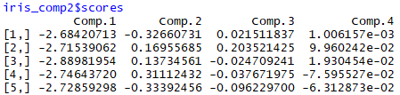
PCA: Loadings
Step 10: Component Loadings
Percentage of variance in a variables, explained by a component.
iris_comp2 <- princomp(iris_pca, scores = T)
iris_comp2$loadings
Total variance in component 1 is explained by sepal_len, petal_len and petal_wid.
sepal_len loads to all the four components.
Step 11: Scores: obtain the transformed data.
iris_comp2$scores

Slide 18
PCA: Communality and Rotation
Communality:
Proportion of each variable’s variance that can be explained by the principal components.
By principle, initial value of communality in a principal component analysis is 1.
Rotation:
After initial principal components have been formed, the results may be improved by a rotation.
There are two types of rotation methods:
Orthogonal rotations: Rotation such that two axis remain perpendicular to each other
For example, Varimax rotation.
Oblique rotations: Rotates the axis such that the vertices can have any angle, other than 90 degrees.
For example, Direct oblimin.
Oblique rotations should not be used in case of PCA, because the components should not be correlated to each other.
In other words, the components should be orthogonal.
Use the principal command in R, to conduct a PCA involving rotations.

Slide 19

Orthogonal Rotation

Slide 20
Exploratory Factor Analysis
Model observed variables in terms of smaller underlying, unobservable latent factors.
For example, a certain diploma requires the students take three courses A, B and C.
After some analysis, it is realized that all these three courses employ a student’s quantitative ability and verbal ability.
Hence, the scores in each of these three courses, will dependent on two factors, i.e. student’s quantitative ability and verbal ability.
Consider X to be a vector, such that:
X = (x1, x2, ….., x7) where, x_{i} = input data variables
Consider another vector, that contains the mean values of these input data variables:
  µ = (µ1, µ2, ….., µ7) where, µ_{i} = mean of the input data variables
Consider m observable factors, f1, f2, ….. , fm, where usually m < no. of variables.
Then, x₁ = µ₁ + n₁₁ f₁ + n₁₂ f₂ + ….. + n₁₇ f₇ + ε₁
x₂ = µ₂+ n₂₁ f₁ + n₂₂ f₂ + ….. + n₂₇ f₇ + ε₂
|
x₇ = µ₇ + n₇₁ f₁ + n₇₂ f₂ + ….. + n₇₇ f₇ + ε₇

Slide 21
Exploratory Factor Analysis
The coefficients n_{ij} i.e. the partial slopes are c/a factor loadings.
n_{ij} is the loading of the i^{th} variable on the j^{th} factor.
n₁₁ n_{12 …..} n_{1m}
N = n₂₁ n_{22 …..} n_{2m} = matrix of factor loadings
|
n₇₁ n_{72 …..} n_{7m}
This can also be represented as : X = µ + Nf + ε (seemingly, like a regression model)
Assumptions:
Common factors are uncorrelated with one another i.e. cov(f₁, f₂) = 0
Error terms or specific factors are uncorrelated with one another i.e. cov(ε₁, ε₂) = 0
Common factors are uncorrelated with specific factors i.e. cov(ε_{i}, f_{i}) = 0

Slide 22
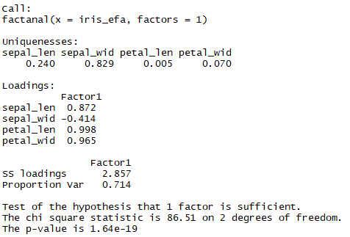
EFA using Principal Component Method
The full principal component extraction model assumes that all the variance is common, and so the communalities are all equal to 1
(i.e. there is no specific variance). It is only when we reduce the number of factors that specific variance is introduced into the model.
iris_fa1 <- factanal(iris_efa, factors = 1)
sepal_len, petal_len and petal_wid
are similar to each other (correlated)
while sepal_wid is unique.
A total of 71.4% of variance is explained
by the factors.
Since the p-value is significantly small,
we may say that our test is good.

Slide 23
EFA using Principal Component Method
The full principal component extraction model assumes that all the variance is common, and so the communalities are all equal to 1
(i.e. there is no specific variance). It is only when we reduce the number of factors that specific variance is introduced into the model.
iris_fa1 <- factanal(iris_efa, factors = 1)
sepal_len, petal_len and petal_wid
are similar to each other (correlated)
while sepal_wid is unique.
A total of 71.4% of variance is explained
by the factors.
Since the p-value is significantly small,
we may say that our test is good.

Slide 24
EFA using PC Method: Rotation
After obtaining the factors, we rotate the axis to see if the variance explained is improved.
There are a number of rotation techniques possible:
Varimax rotation:
Orthogonal rotation that minimizes the number of variables that have high loadings on the factors.
Direct oblimin rotation:
Oblique or non-orthogonal rotation.
Quartimax rotation:
Minimizes the number of factors needed to explain each variable.
Equamax rotation:
Combination of varimax and quartimax rotation, i.e. number of variables highly loading on a factor, as well as the number of factors needed to explain a variable are minimized.
Promax rotation:
Oblique rotation, which allows factors to be correlated.

Slide 25
EFA using Principal Axis Factoring
In the principal axis factoring method, we make an initial estimate of the common variance in which the communalities are less than 1.
This initial estimate assumes that the communality of each variable is equal to the square multiple regression coefficient of that
variable with respect to the other variables.
The principal axis factoring method is implemented by replacing the main diagonal of the correlation matrix (which consists of all
ones) by these initial estimates of the communalities
EFA using Principal Axis Factoring in R:
factor.pa() method in the psych package
fa() method, also in the psych package: use fm=“pa” in the method parameters.
Irrespective of whichever technique we use for factor analysis, the eigen values, # factors to retain, scree plot etc. are used in the
similar way as we did for PCA.

Slide 26
EFA: KMO Test
Kaiser Meyer Olkin (KMO) test is a measure of how suited the data is, for factor analysis.
This statistic measures the proportion of total variance among variables, which might be common variance
KMO returns values between 0 and 1.
Values between 0.8 and 1 indicate that the sampling is adequate.
Values between 0.5 to 0.8 indicate that the sampling is not adequate and data should be corrected before conducting EFA.
Values below 0.5 indicate that there are large partial correlations, which is a problem for factor analysis.
In words of Kaiser:
0.00 to 0.49 unacceptable
0.50 to 0.59 miserable
0.60 to 0.69 mediocre
0.70 to 0.79 middling
0.80 to 0.89 meritorious
0.90 to 1.00 marvelous
Use the KMO(cor_matrix) function in R.

Slide 27


Questions?

